Slide 1
Pilot testing services and a case study to reduce organics Devendra Borikar, Laura Zettler, Jeff Avedesian, Lindsay Ariss, Luc Léonard, Denis Dolbec, Michel Plourde, Souleymane Ndiongue May 16, 2018 55th Annual Northeastern Ontario Water works Conference Sudbury, Ontario

Slide 2
Pilot Testing Services
Objective to support our clients by providing information and education
To enhance operator’s understanding of
- their source water characteristics
- the performance of their treatment &
- alternative treatment options

Slide 3
Some of the Technologies at the WCWC
Conventional treatment
Dissolved air floatation (DAF)
Slow sand filtration
Green sand filtration
Membrane systems (MF,UF,NF & RO)
Cartridge and pressure filters
Ion exchange
Ozone, UV and chlorine disinfection
Advanced oxidation
pH adjustment
Notes:
Many of these technologies are portable.
The Centre can buy a pilot system,if required

Slide 4
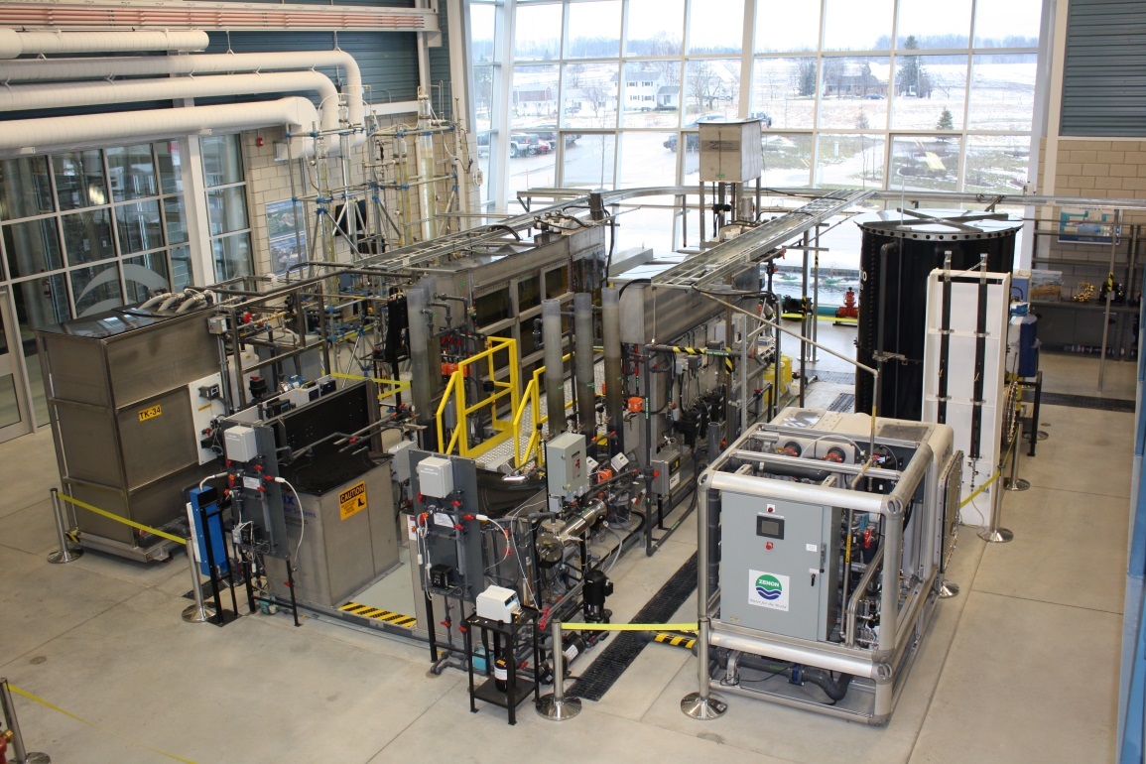
Types of Pilot Testing/Bench scale testing
Offsite
Raw water is transported to the Walkerton Clean Water Centre for testing

Slide 5
Types of Pilot Testing/Bench scale testing
Onsite
The pilot testing is conducted at your location
At the water treatment plant

Slide 6
How to initiate pilot testing?
Contact the Walkerton Clean Water Centre
Site visit to collect information
Proposal
Testing plan is created
Acceptance of the proposal by the client
Conduct pilot testing as per proposal
Report (Method and Results)

Slide 7
Case Study Using fixed bed ion-exchange treatment to enhance the reduction of organics

Slide 8
Introduction
A small drinking water system serving a population of
> 5,000 in Northern Ontario
Source water – river
Water treatment plant (WTP) – Flow rate >10,000 m³/day
Current WTP
- Conventional treatment (alum)
- Hydraulic flocculation tanks
- Settling tanks
- Anthracite (600 mm) and sand (350 mm) filters
- Chlorine system for primary disinfection
- Chloramination system for secondary disinfection

Slide 9
Issues with high organics
Raw water organics (DOC) level -16.5 mg/L
The town uses enhanced coagulation process
( wet alum dose - 200 mg/L)
In spite of effective enhanced coagulation processes which reduces 65% of organics, anthracite/sand filtered water has a DOC level of approximately 5.73 mg/L
Issues as per Technical Support Document for ODWSOG (MOECC, 2006).
- DOC level of filter effluent > AO - DOC : 5 mg/L
- Exceedance of THMs - MAC : 100 µg/L

Slide 10
Objectives
To determine:
- the reduction of organics and THMs/HAAs
by a fixed bed ion exchange system
- the overall effect of the ion exchange process on treated
water quality
- the effect of varying flow rates through the ion exchange
systems on organic matter reduction

Slide 11
Brine
Tank
IX Effluent
WTP Filter
Effluent
Tank 1
To Drain
IX Effluent
Tank 2
To Drain
Legend:
Sample Port Flow Meter UV abs. meter

Slide 12
Results

Slide 13
Raw Water Quality Characteristics
Parameters | Average (Experiment 1 & 2)
DOC (mg/L) | 16.5
UV absorbance at 254nm (cm ⁻¹) | 1.011
SUVA (L/mg-m) | 6.14
Alkalinity (mg/L CaCO₃) | 69
True colour (Pt- Co) | 146
Apparent colour (Pt- Co) | 203
Turbidity (NTU) | 7.56
pH | 7.61

Slide 14
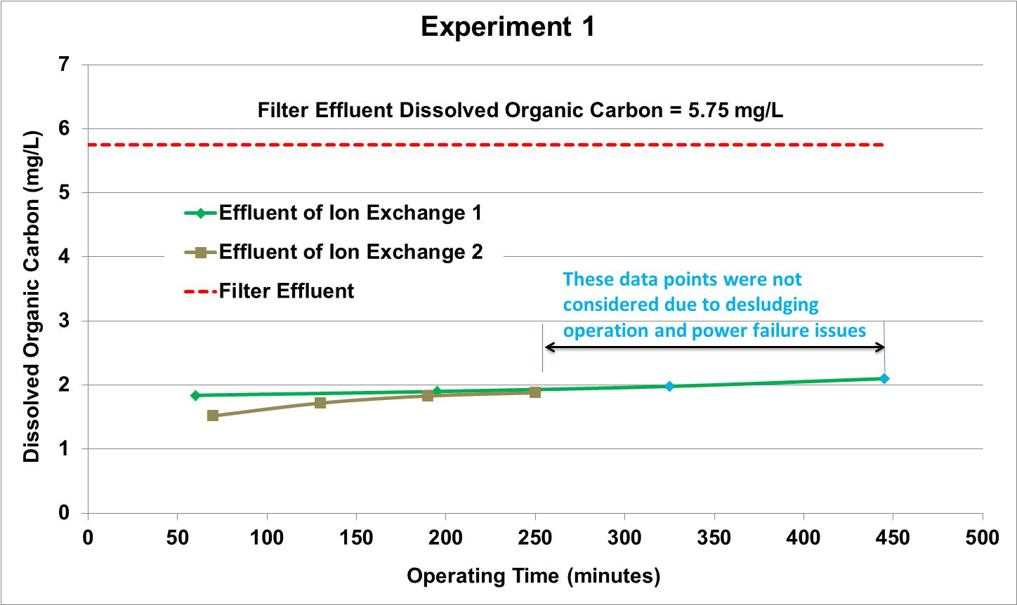
Additional DOC Reduction with EBCT - 2.5 min
Raw water :16.4 mg/L and Filtered effluent: 5.75 mg/L
IX treated water: 1.84 -1.90 mg/L
Additional DOC reduction: 68%

Slide 15
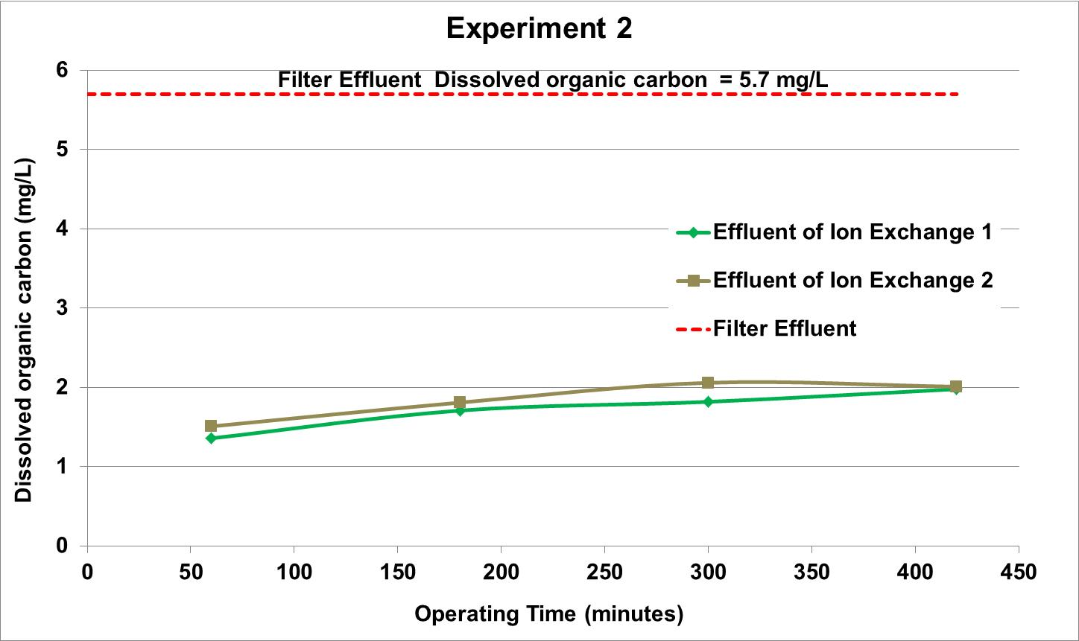
Additional DOC Reduction with EBCT - 5.2 min
IX treated water: 1.36 - 2.06 mg/L,
Additional DOC reduction: 69%
Treated water DOC level increases with time

Slide 16
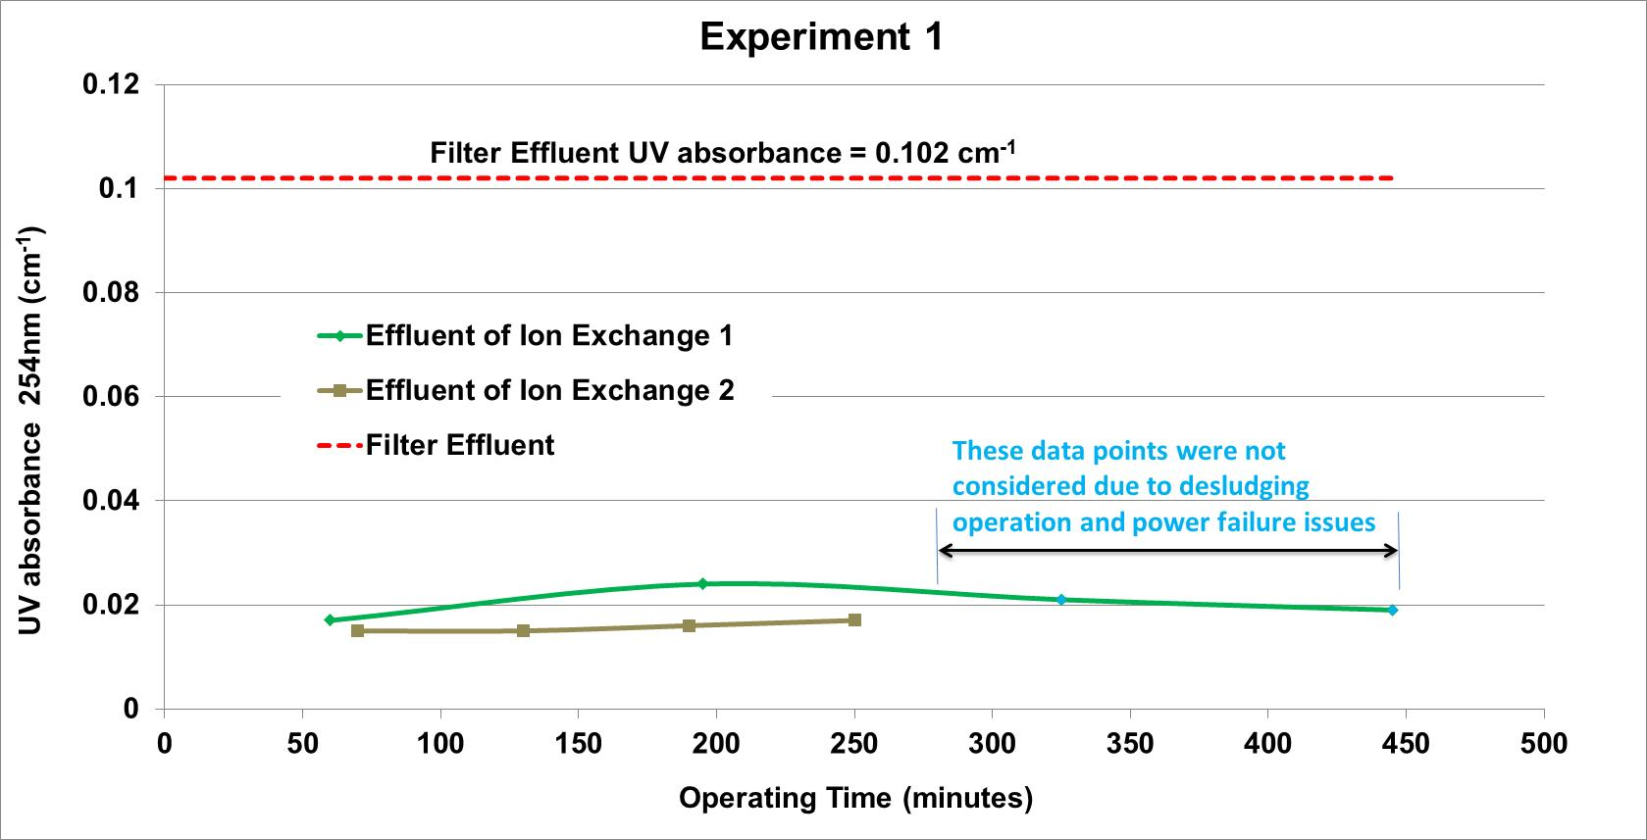
Additional UV absorbance Reduction with EBCT - 2.5 min
Reduction up to Filtered effluent: 90%
Additional UV absorbance reduction by Ion-exchange process: 84%

Slide 17
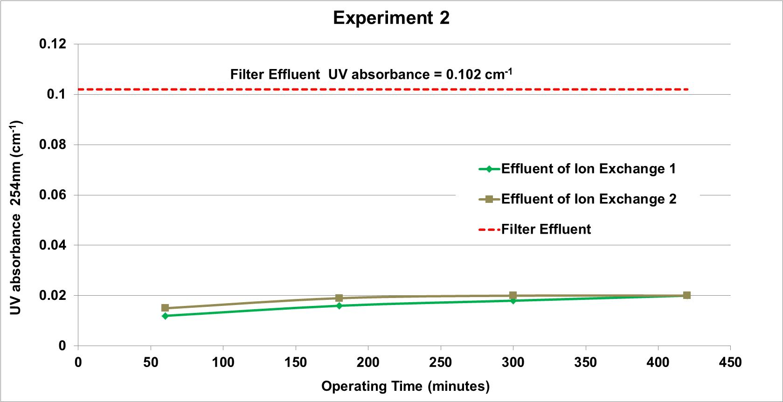
Additional UV absorbance Reduction with EBCT - 5.2 min
Additional UV absorbance reduction by Ion-exchange process: 82%

Slide 18
Take away message from DOC and UV absorbance trends
Overall additional DOC reduction: 69%
Additional UV absorbance reduction : 83%
IX process reduces more aromatic fraction
Because two different EBCTs showed similar performance within a range of flows which indicate that EBCT can be decreased or flowrate can be increased.
Performance decreases as runtime increases and therefore UV absorbance can be used as DOC surrogate for regeneration frequency
On-line UV absorbance meter can be used as a monitoring tool for DOC

Slide 19
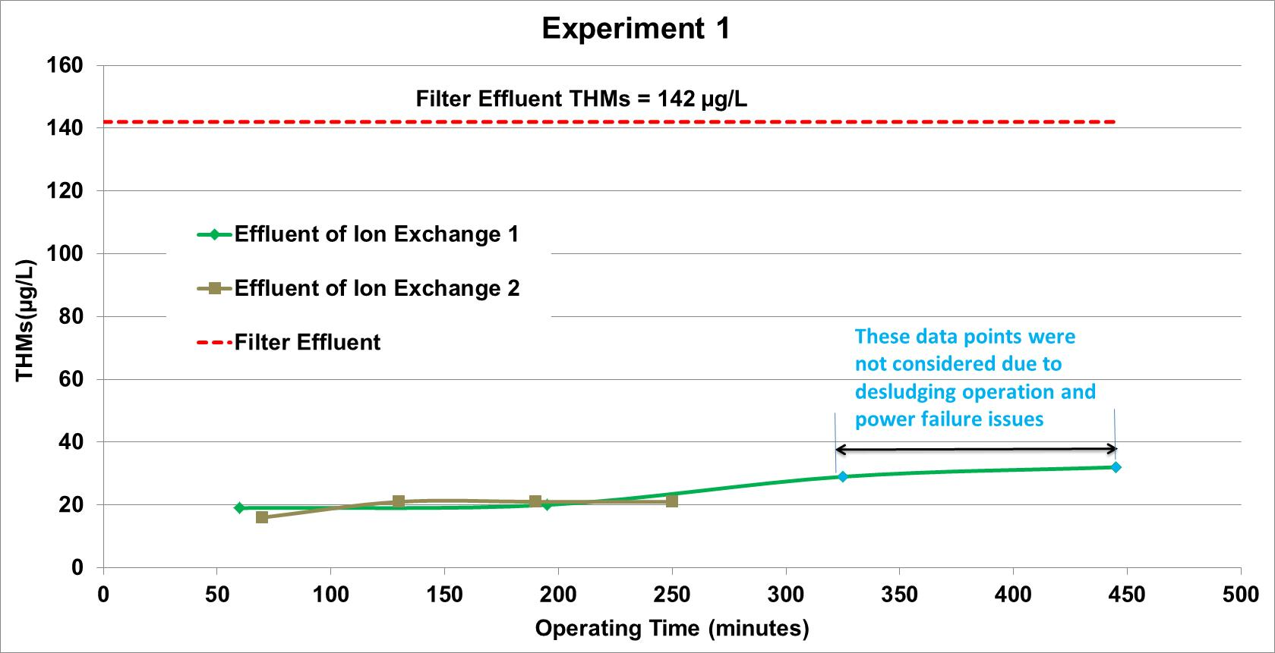
Additional THMs Reduction by IX process
SDS-THMs conditions: 6.3 mg/L chlorine and 2-day detention time
Raw water : 238 µg/L, Filtered water : 142 µg/L
Average IX treated water : 20 µg/L
Additional THMs reduction by IX process: 86%

Slide 20
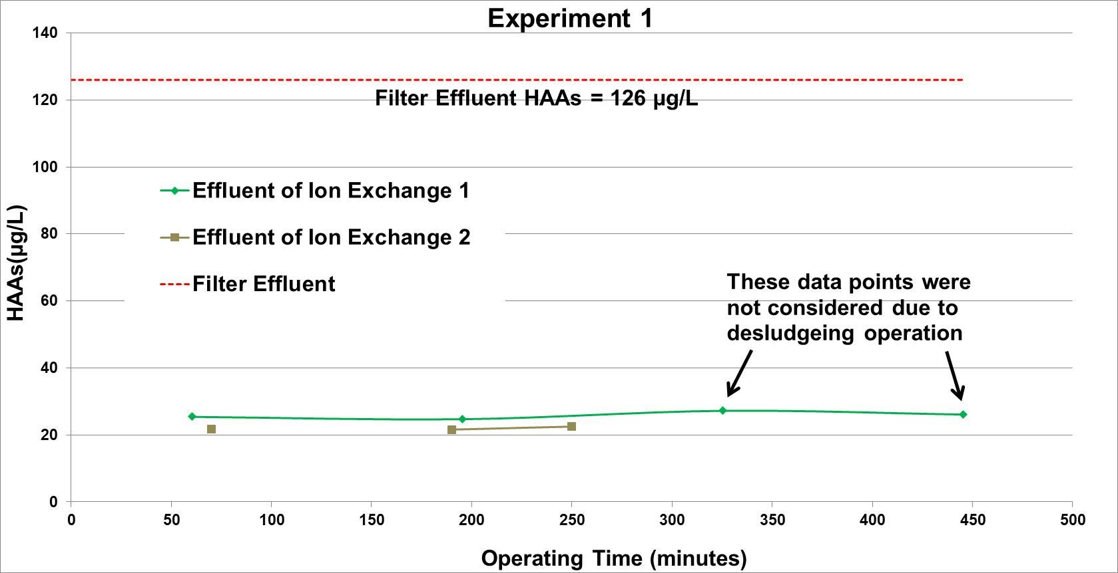
Additional HAAs Reduction by IX process
Raw water : 185 µg/L, Filtered water : 126 µg/L
Average IX treated water : 23 µg/L
Additional HAAs reduction by IX process: 82%

Slide 21
Impact on water quality
Parameters | Raw water | After enhanced coagulation followed by filtration | After IX process *
Alkalinity in mg/L as CaCO₃ | 69 (The town add soda ash to increase alkalinity) | 33 | 8
pH | 7.6 | 6.4 | 5.0
Chloride (mg/L) | N/A | 1.6 | 92
* Needs adjustment to maintain stability in Distribution System

Slide 22
Operational aspect / concern of IX process
Runtime and backwash frequency
Salt consumption
Disposal of regeneration water
Two experiments tested at 3.0 and 1.5 gpm/cubic ft flowrate :
- Organics removal were similar, indicating potential for
higher hydraulic loading capacity
(maximum 10 gpm/cubic ft)

Slide 23
Conclusions
Based on the pilot testing, IX process additionally reduced
- 69% of DOC
- 83% of UV absorbance
The IX process reduces DOC from 5.75 mg/L to 1.78 mg/L
Consequently, IX treated water showed a significant additional reduction of
- 86% in THMs (from 142 µg/L of filter effluent to 20 µg/L)
- 82% of HAAs (from 126 µg/L of filter effluent to 23 µg/L)

Slide 24
Conclusions
It decreases the pH and alkalinity and increases chloride. Creates corrosion concerns.
Online UV absorbance monitoring: a useful tool to provide operations staff with process performance and optimization
Other maintenance and operational challenges
- High salt consumption
- Regeneration waste water disposal

Slide 25
Contact Information
To learn more about how the WCWC supports its clients with pilot testing services contact:
Souleymane Ndiongue, Manager, Research & Technology Institute
1-866-515-0550 ext 308 sndiongue@wcwc.ca
Devendra Borikar, Lead Technology Demonstration at
1-866-515-0550 ext. 313 dborikar@wcwc.ca

Slide 26
Many Thanks

